Slide 1
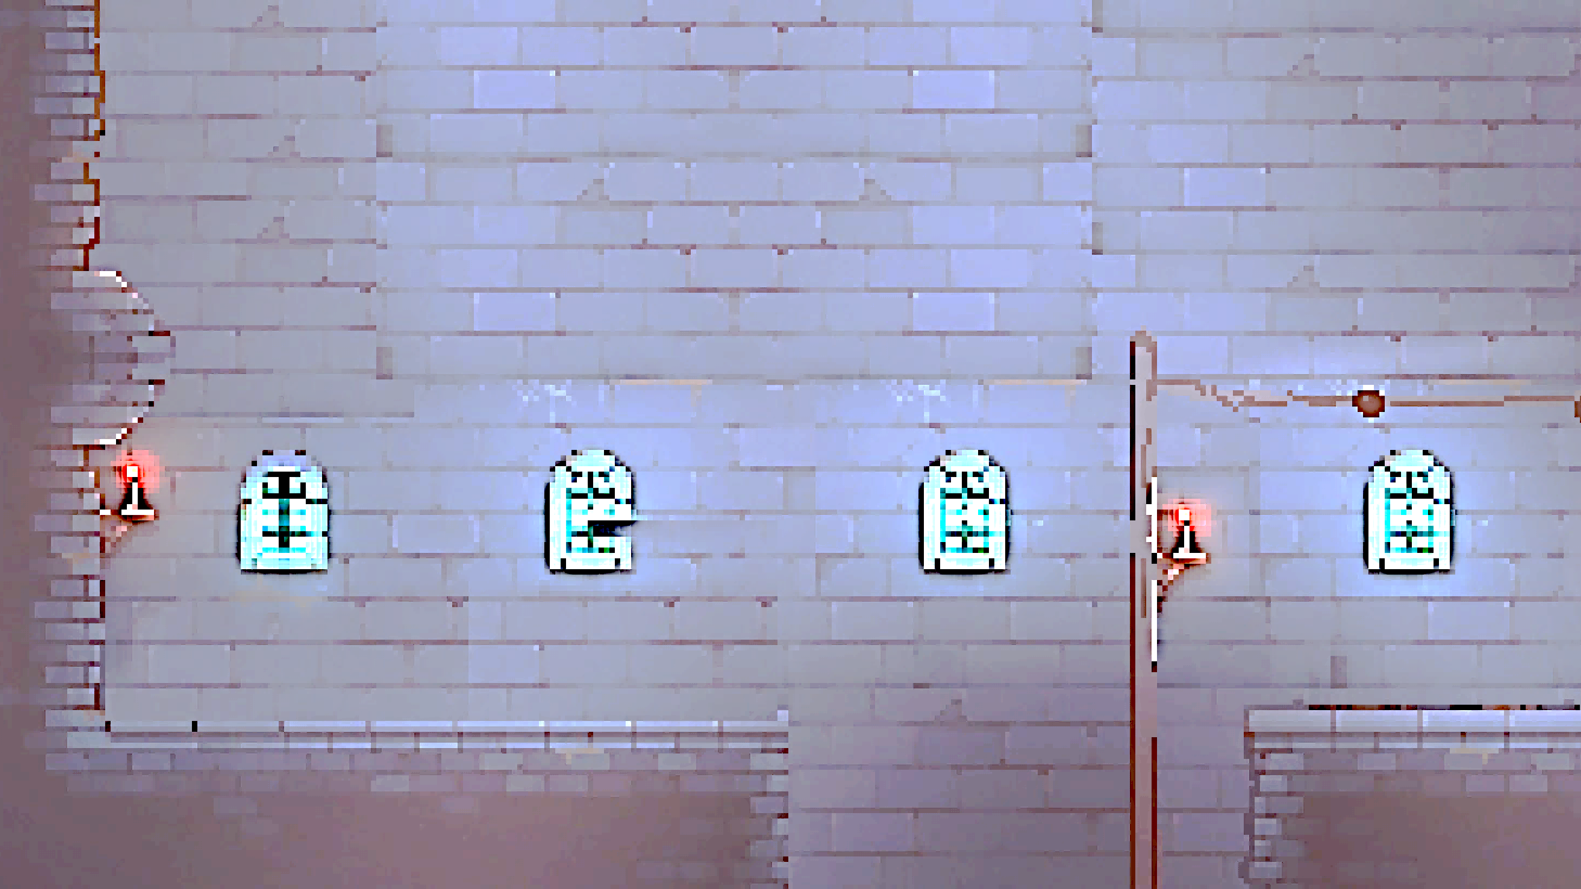

Think Outside The Room
By

Slide 2
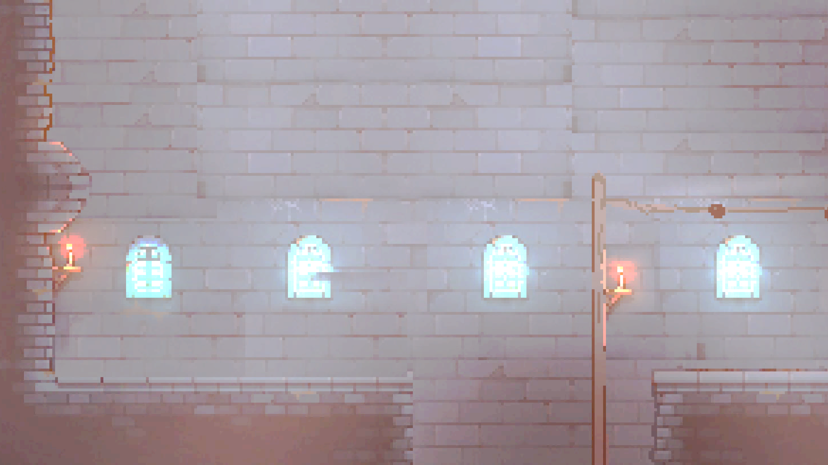
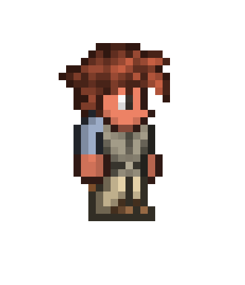


Progress Report
1
2
3
4
5
Code Structure
GUI
Game Logic
Adjusting GUI
Debugging
Chat
Testing
Last Adjustment

Slide 3
Progress Report
Lessons Learned:
Communication
More structured workflow
Better version control
Clear task distribution

Slide 4
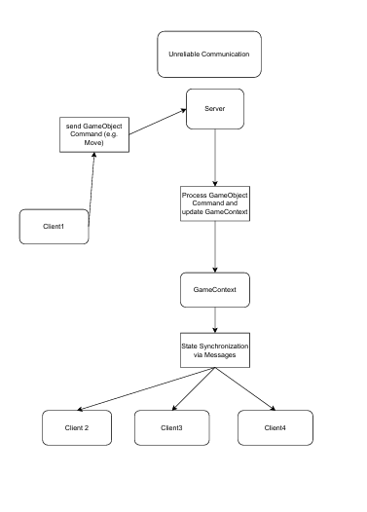
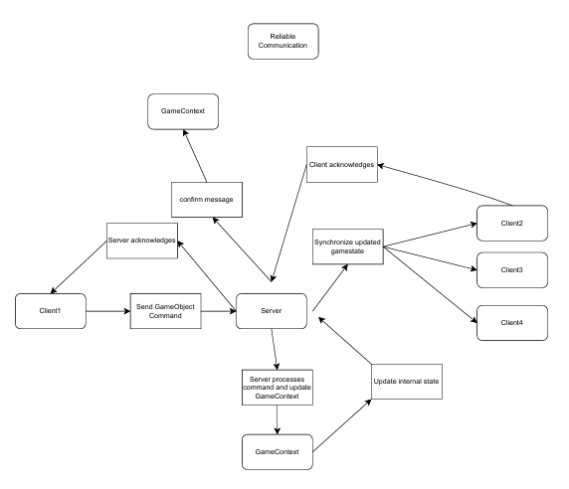
Rules to Code
Notes:
Central Game Context:
The game uses a central GameContext class that holds the current game session, active players, game objects, and UI-related state.
It acts like the brain of the game: everything goes through it.
Game Objects with Identity:
All entities in the game (players, items, projectiles, etc.) are represented as individual GameObject instances.
Each object has a unique ID and knows its type, position, and state.
State Synchronization via Messages:
Clients and server exchange structured messages (e.g., CREATEGO, MOVE, REGISTER) to modify and sync the game state.
This decouples the frontend from the backend and enables multiplayer logic.
Command-Based Logic Handling:
The server handles game logic through a CommandRegistry and individual CommandHandlers, making the system modular and easily extendable.
Each command like JOINGAME, SELECTGO, etc., has a well-defined handler.
Best-Effort vs. Reliable Communication:
Game updates (like position) are sent using "best effort" (fire and forget), while important commands (e.g., login, object creation) use a reliable UDP system.
Encapsulation and Separation of Concerns:
Networking, game logic, UI, and object creation are cleanly separated in the codebase.
This structure makes the game easier to debug, test, and extend.

Slide 5
Technology
Hamachi
Lombok
Code with me
Reflection library

Slide 6
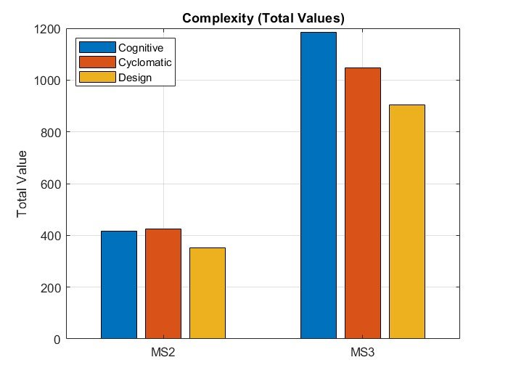
QA-Concept
🧑‍🤝‍🧑 Team Collaboration
🔀 Version Control (GitHub)
🕵️ Code Review
📐 Coding Standards

Slide 7
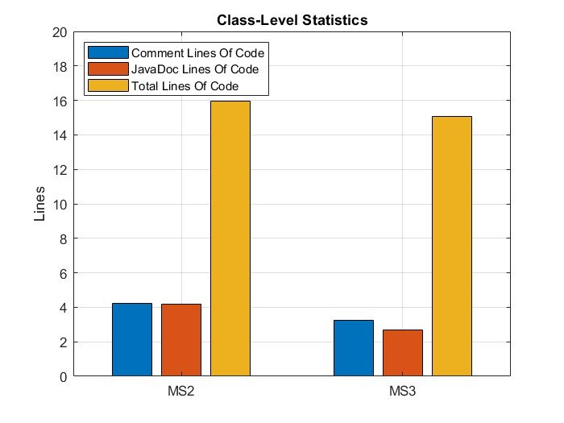
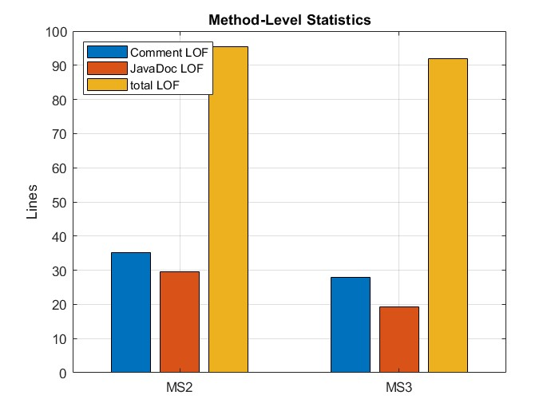
QA-Concept
QA-Concept

Slide 8
About Think Outside The Room
Genre: 2D Jump and Run Puzzles- Platformer
Players: 2 Players with a Character Twist
Goal :to finish this level through skillful jumping, puzzle solving and cooperation

Slide 9
About Think Outside The Room
Mechanics
Jumping: Up Arrow key
Movement: Left & Right Arrow keys
Grabbing: hold E
Throwing: hold F

Slide 10


Demo

